Slide 1

NEFS = J2EE Simplified
The Netspective Enterprise Frameworks Suite (NEFS) is the fastest path to advanced J2EE applications

Slide 2

Agenda
What does NEFS do?
How does NEFS work?
Application Presentation Themes
Hierarchical Application Navigation
Auto Validated Forms
Declarative Security
Declarative SQL Queries and Reports
Dynamic SQL Queries and Reports
Leveraging Existing Investments
Feature List
Conclusion – Why Use NEFS?

Slide 3
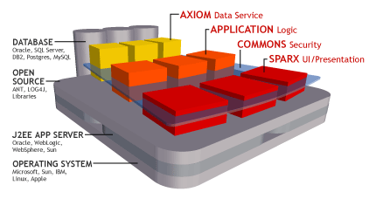
What does NEFS do?
The Netspective Enterprise Frameworks are a suite of Java libraries and add-on tools that help your software development team:
  Quickly create great-looking web-based applications that are easier to use but just as sophisticated as desktop-based applications (presentation layer);
  Painlessly connect to multiple data sources simultaneously and allow modern web-based applications to consume legacy data (data layer);
  Easily secure web-based applications using rock-solid role-based access control (security layer);
  NEFS does does not replace existing operating systems, app servers, IDEs, databases, or other favorite tools.

Slide 4
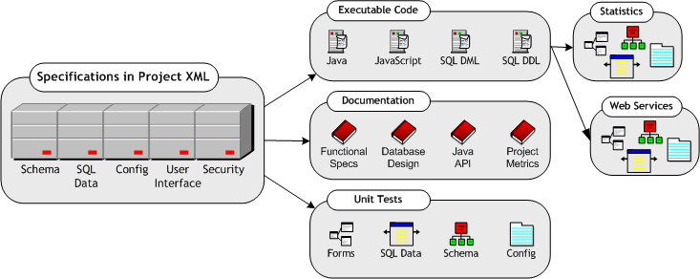
What does NEFS automate?
Generates up to 80% of all code a typical business application needs.
Custom code and business logic remains separate and reusable.
Developers supply XML declarations categorized below and NEFS generates everything else on the right.

Slide 5
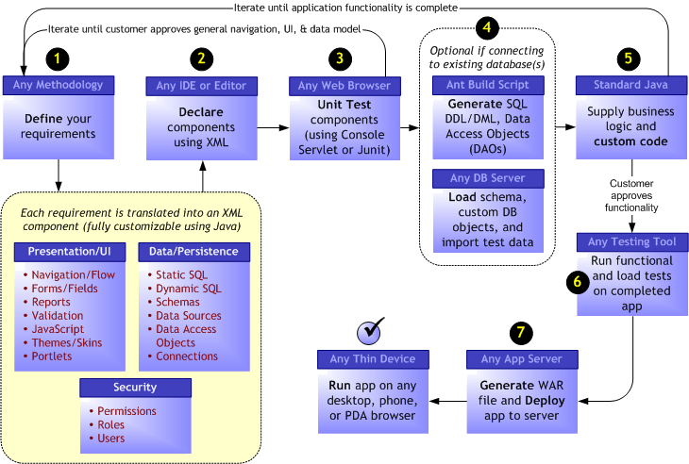
How does NEFS work?

Slide 6
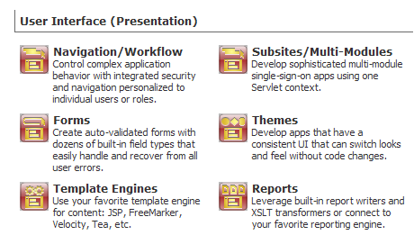
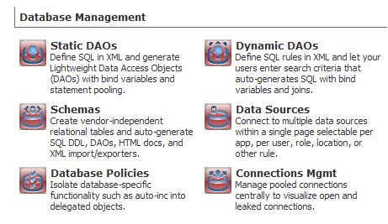
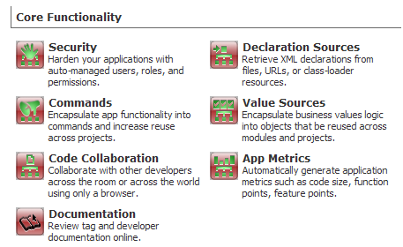
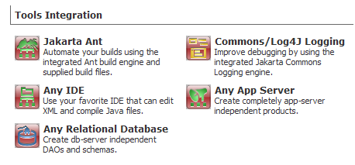
NEFS Features Overview

Slide 7
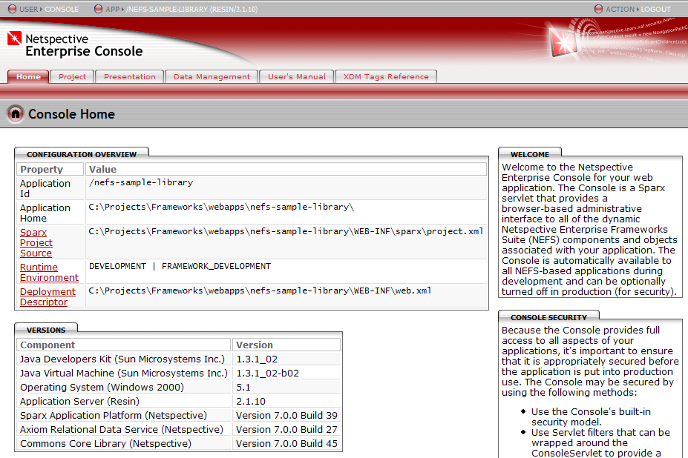
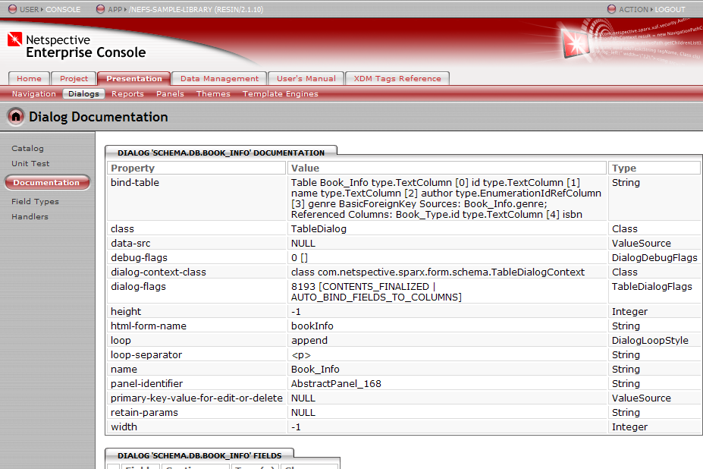
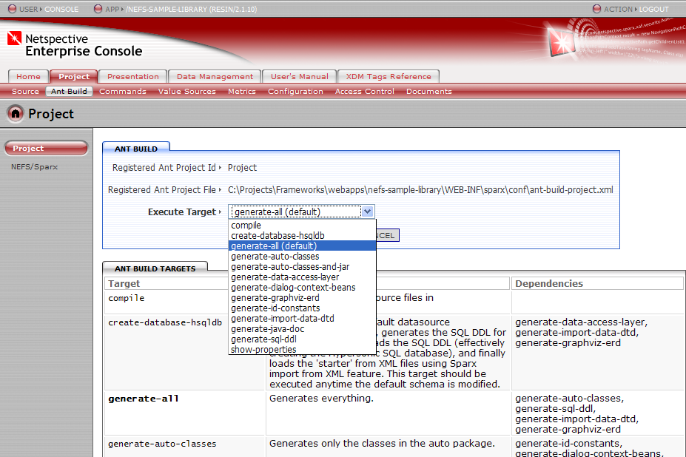
Netspective Enterprise Console
The Enterprise Console provides an IDE-independent mechanism to help you manage all your application components.
Improve the quality of your app by running the auto generated unit tests within the Console.
Better understand your app code through auto generated documentation.

Slide 8
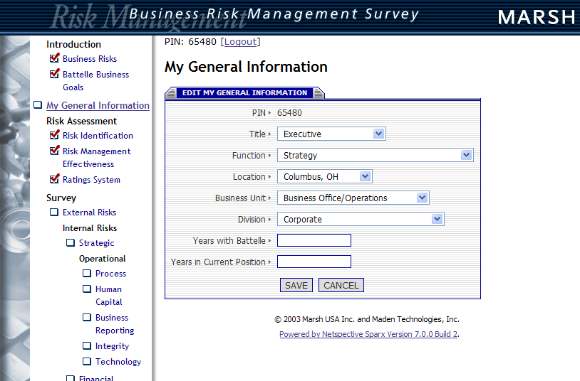
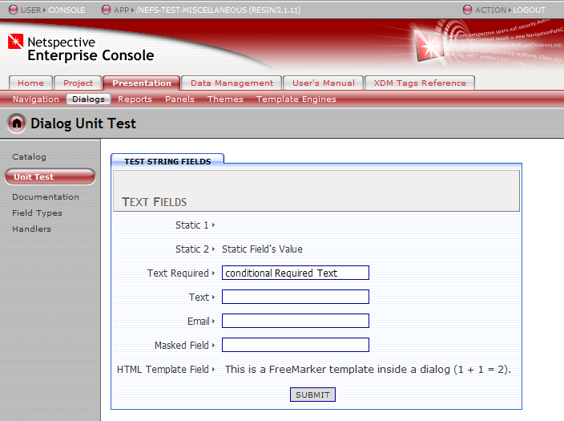
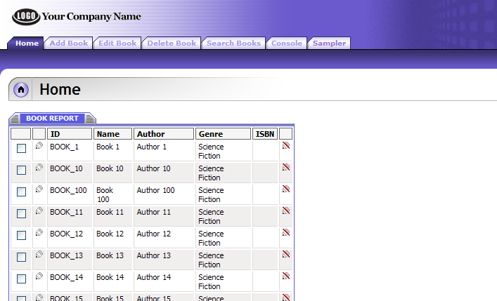
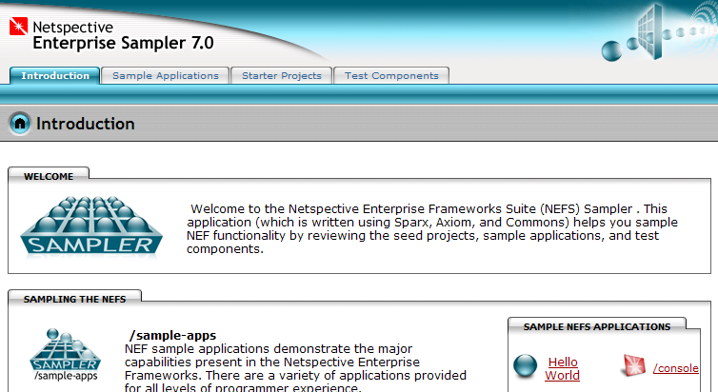
Application Presentation Themes
Your applications can look as great as they work.
You won’t need to sacrifice appearance for power or vice-versa.

Slide 9
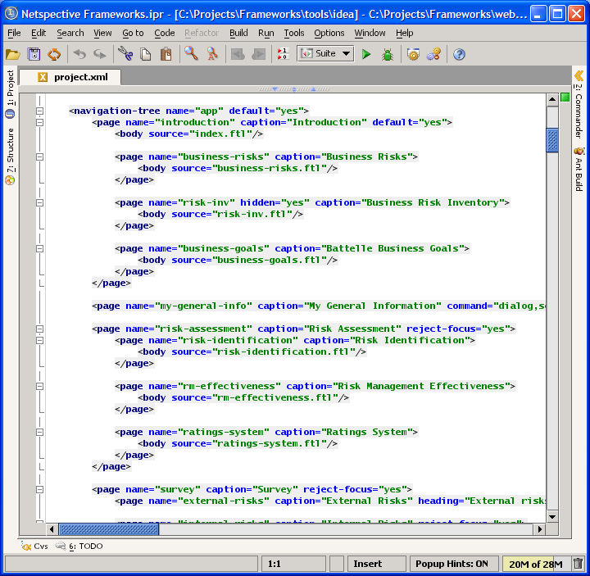
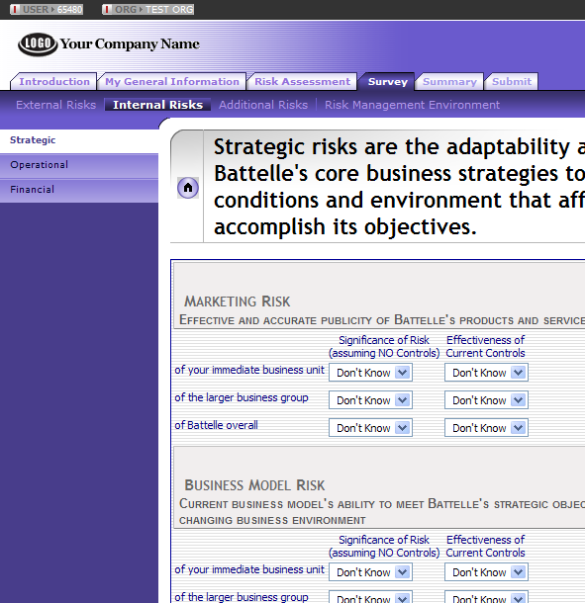
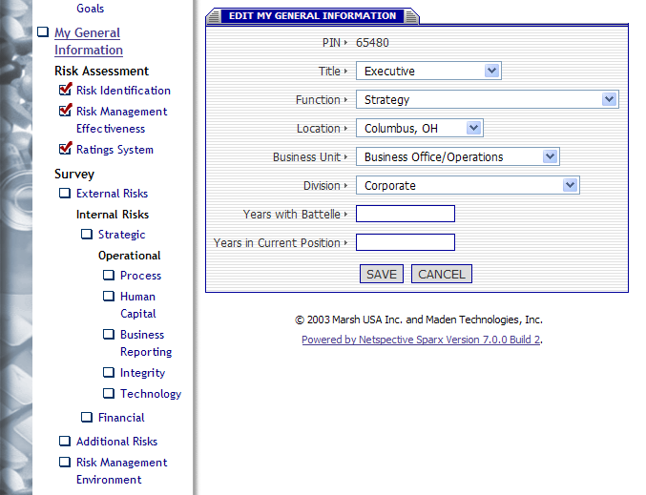
Hierarchical Application Navigation
Using your favorite IDE or editor, declare simple tags like <page> and <body> to create sophisticated hierarchical navigation…
NEFS automatically generates all HTML, CSS, images, etc and allows easy switching between different themes.

Slide 10
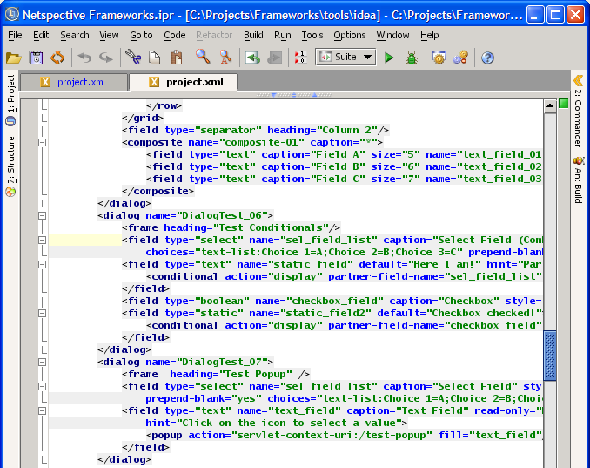
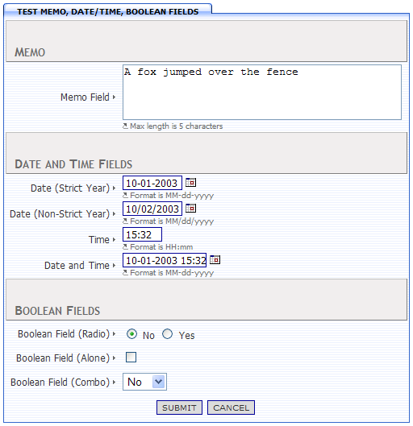
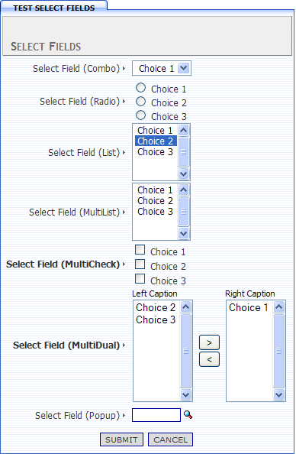
Auto Validated Forms
Use tags like <dialog>,<field>, and <validate> to create entire forms.
HTML generation, population of form data (including repopulation of data on error), and validation is completely automatic. A dozen lines of XML produces hundreds of lines of Java, JavaScript, and HTML.

Slide 11
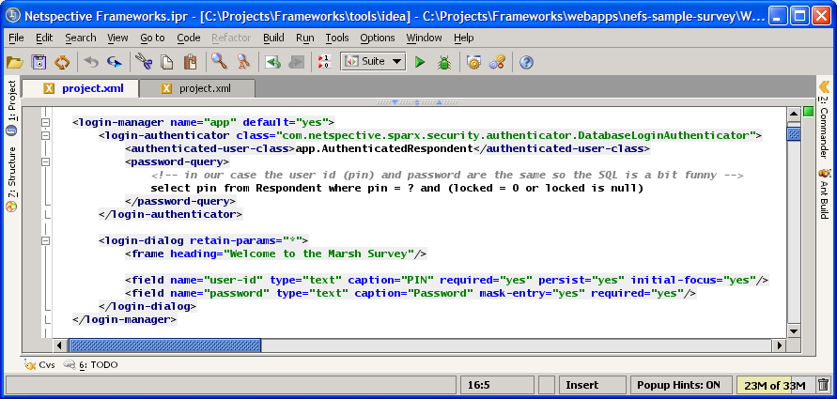
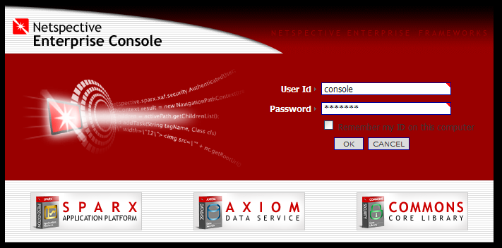
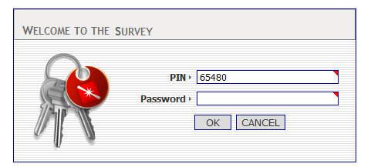
Declarative Security
You can easily secure your mission-critical app by using simple tags like <login-manager>,<login-authenticator>, <permission>, and <role>. Never worry about forgetting to secure a page again.
JAAS authentication, database authentication, and custom authenticators transparently protect your application code without requiring any extra work on your part.

Slide 12
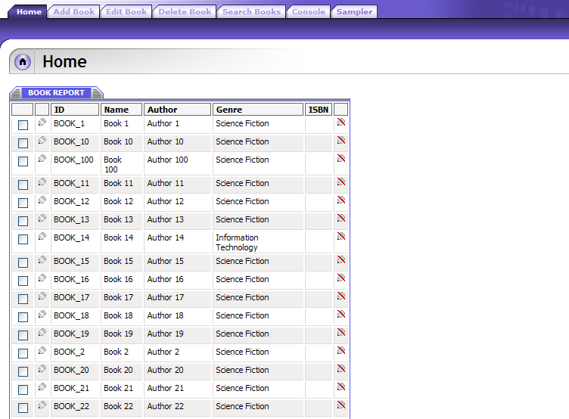
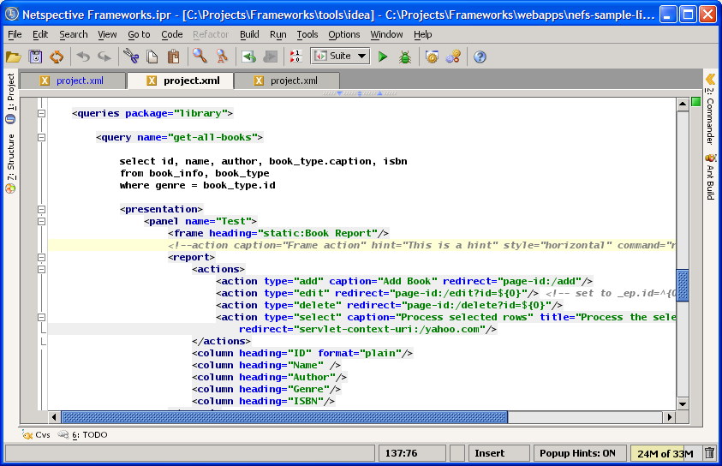
Declarative SQL Queries and Reports
Use the powerful <query> tag to extract data from ORACLE, SQL*Server, MySQL, or any other relational database. Using a single tag you can get data from a one db or multiple data sources simultaneously.
When you need to present your SQL data, just drop in the handy <report> tag which generates user interfaces that allow record adds, edits, and deletes with almost no code.

Slide 13
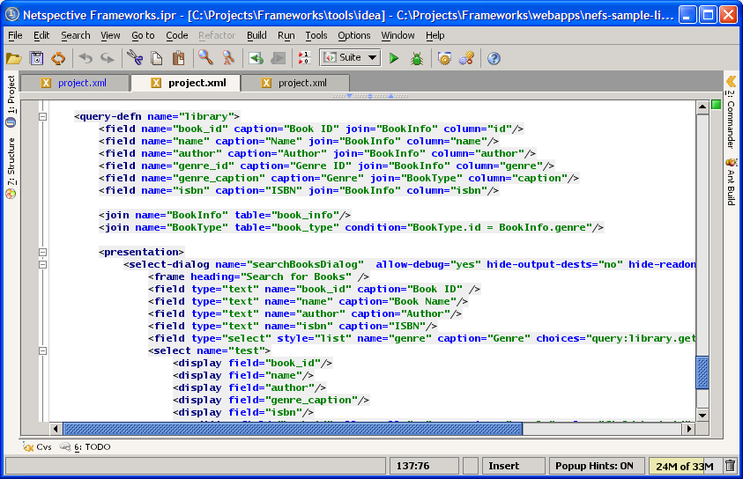
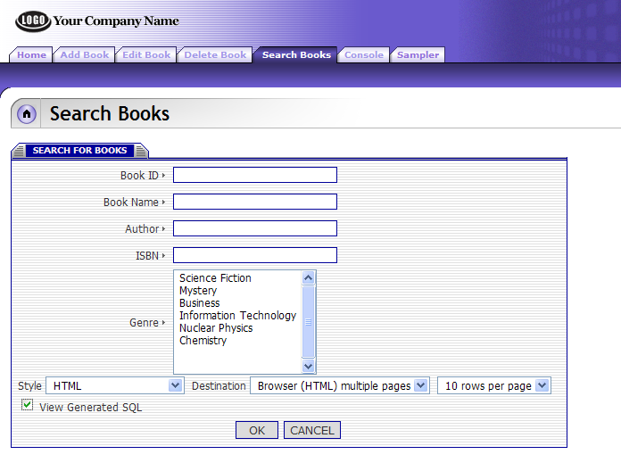
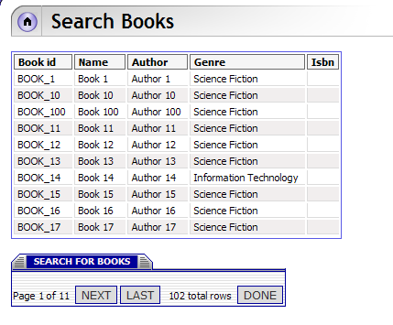
Dynamic SQL Queries and Reports
Tired of writing hundreds of lines of code for each search dialog? You’ll appreciate the <query-defn>, <field>, <join>, and <select-dialog> tags that define rules to map user interface fields to specific tables and columns in your database. Search dialogs can be written in hours instead of days.
Once the map is created, NEFS automatically constructs search forms. Then, using data obtained from a user at run-time, the system automatically generates SQL, executes the SQL, and produces pageable reports with no java coding.

Slide 14
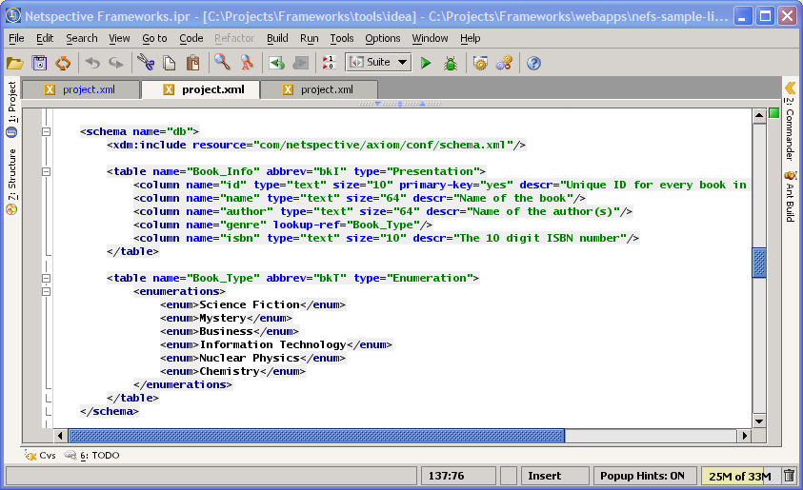
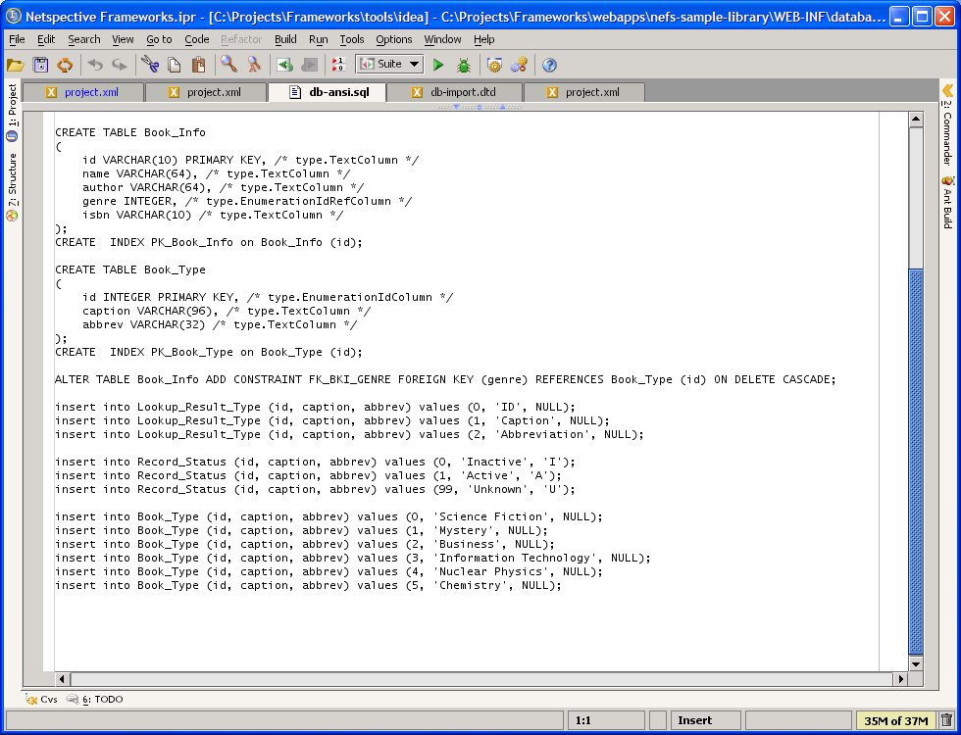
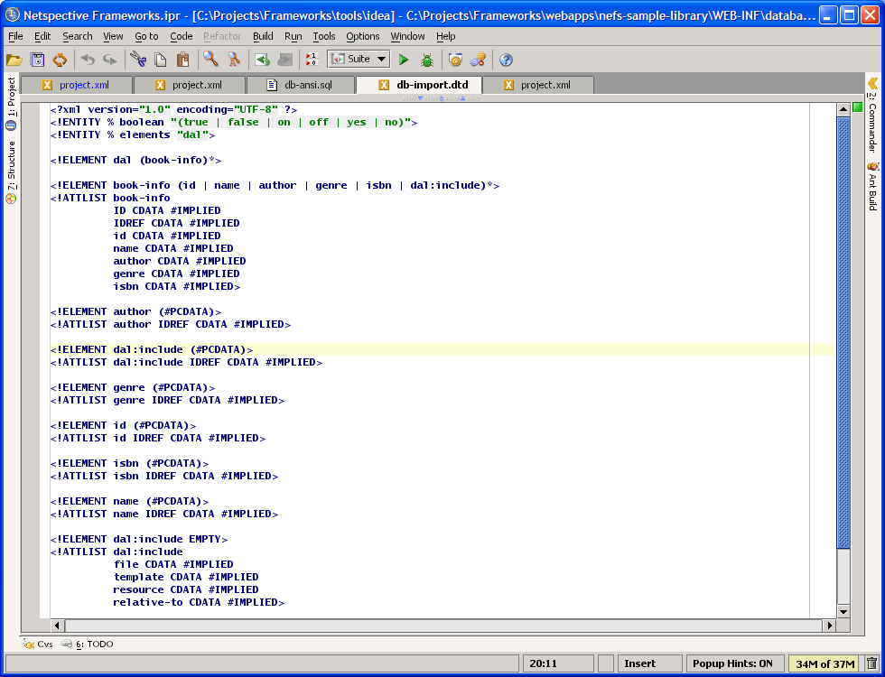
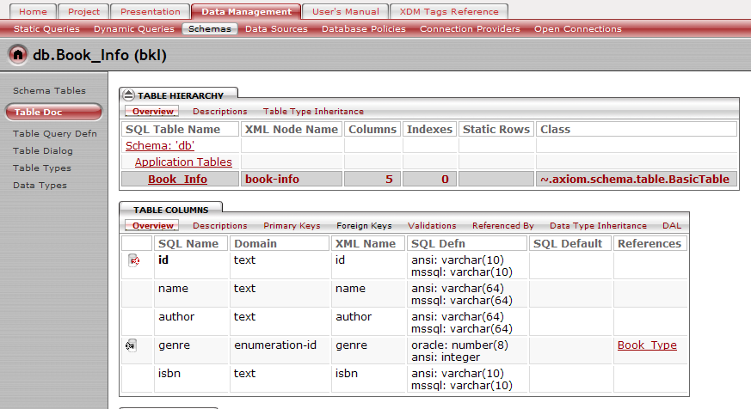
Database Schema Management
Tags like <schema>, <table>, <column>, and <accessor> are used to create a persistence mechanism by defining new database structures or mapping objects to existing relational databases.
Instead of spending weeks hand-coding the schema and O-R map, all SQL DDL and XML data import, DAO, and VO classes are automatically generated in minutes. And, it’s database-independent.

Slide 15
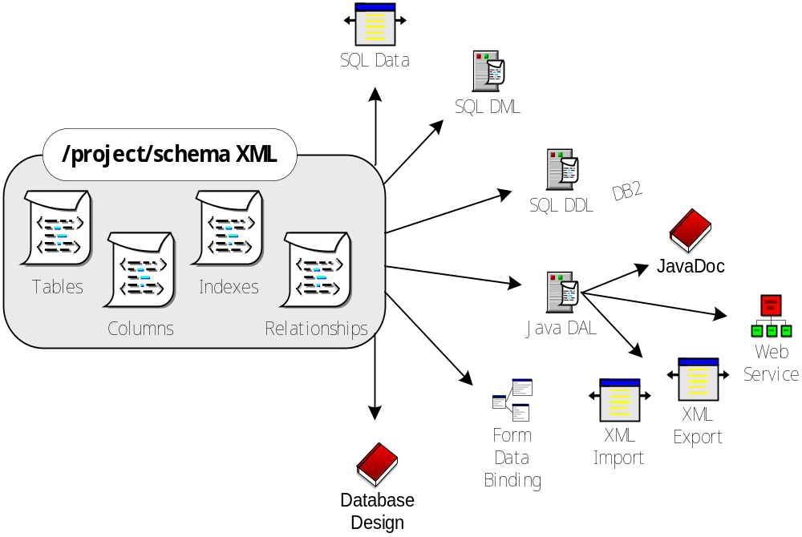
Database-independent Persistence

Slide 16
Leveraging Existing Investments
NEFS does not compete directly with most tools; therefore increasing ROI
Tool Category | Representative Tool Vendors | NEFS Fit | Sparx Scope
Application Framework | Avalon, Struts, Turbine, Barracuda, Expresso | Can Replace | ˜˜˜˜˜˜
O-R Mapping Framework | CocoBase | Can Replace | ˜˜˜˜˜˜
Security Framework | Netegrity | Can Replace | ˜˜˜˜˜˜
Database/ERD Design Tools | Embarcadero, ORACLE, Rational, TogetherSoft | Enhances | ˜˜˜˜˜
Analytics and Reporting Tools | Informatica, Crystal Reports, Actuate | Enhances | ˜˜˜
Template Language | Tag libraries, Cocoon, PHP, Velocity, ASP | Enhances | ˜˜˜
Portal and CMS Servers | JetSpeed, Brock, IBM, Microsoft SharePoint, BroadVision | Enhances | ˜˜˜
CASE Tools | Rational Rose, UML, TogetherJ, Elixir | Enhances | ˜˜
Unit Test Tools | JUnit, HttpUnit | Enhances | ˜˜
Functional and Load Test Tools | Mercury, Parasoft, Microsoft, Rational | Works with
IDE | JBuilder, NetBeans, Eclipse, Visual Studio, Visual Café | Works with
Transaction Server | MTS, DAO, TXSeries, Tuxedo | Works with
Debuggers, Profilers | Microsoft, IBM, Sun, Sitraka JProbe | Works with
Version-control Tools | ClearCase, CVS, Perforce | Works with
Database Server | IBM, ORACLE, Microsoft, mySQL (Free) | Includes
Application Server | Weblogic, Tomcat (Free), Websphere, Resin, JRun | Includes
XML, XSLT Tools | Xalan and Xerces (Free) | Includes
Build and Logging Tools | Ant and Log4J (Free) | Includes
Web Server | Apache or IIS (Free) | Includes

Slide 17
General Features
Complete three-tier application design support
Works with any IDE, editor, studio apps
Supports, but does not require, EJBs
Native J2EE API always available
Low learning curve, can utilize less experienced engineers
Works well with other frameworks
Source code available
Ability to version-control components and apps
Complete operating system and app-server independence
Thorough documentation
Many Sample applications
Future capability of migrating to .NET if required

Slide 18
Architecture Features
J2EE Design/Architecture Patterns
Application Integration Patterns
Application Functionality Patterns
Web-services
Externalization of Resources
Executable Specifications
Logging and Performance Stats
Business Rules Repository
Centralized Configuration Parameters
Allows production, testing, development modes
Code Generation

Slide 19
Presentation Layer Features
Forms and controls (advanced controls like e-mail, credit card, date/time with popup calendar, etc can automatically validate themselves)
Client-side validation
Server-side validation
No new template language (uses existing ones like FreeMarker, Velocity, and JSPs)
Automatic form reload on error
Dialog data state machine
Complete HTML generation
Data binding to presentation layer
Reports
Navigation and workflow (automatic creation of menus, submenus, etc)
Wireless, PDA, browser support
Multiple skins support (with no code changes)
Presentation object performance statistics

Slide 20
Data Management Layer Features
Schema management
Lightweight Data Access Objects (DAOs)
Object-relational mapping and persistence
Connection pooling
SQL DML generation
SQL DDL generation
Static SQL queries library
Dynamic SQL queries library
HTML design documentation
Dynamic data sources
SQL performance statistics
Transaction management and isolation

Slide 21

Conclusion – Why Use NEFS?
Improves developer productivity and reduces time to market by eliminating repetitive coding through an extensive library of pre-built and well-tested e-business functionality and database components.
Requires less-qualified engineers to complete a project by using XML to code in a declarative style instead of a programmatic style.
Reduces the number of engineers on a project by producing and automatically maintaining process artifacts like unit tests and documentation.
Increases reusability and consistency across projects by providing built-in metrics, an administration console, and performance statistics.

